Slide 1
What’s wrong with this data visualization?
Adapted for CGT 2700 Data Visualization
Group 8

Slide 2
Group 8
Group Members
Instructions
Keegan Palonis
Ricky Zhang
Jordan Cooley
Tyler Nielson
Scribe: Keegan Palonis
Examine the visualization on the next slide
Determine what’s wrong with the visualization
Then, provide recommendations on how the group would REFINE the visualization
Use any of the resources mentioned in previous lectures and readings

Slide 3
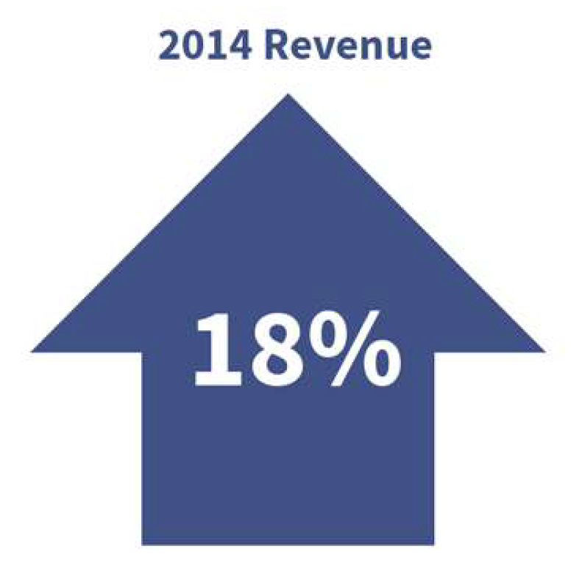

Slide 4
What is it?
Let’s say you’re an investor of RediMedico, the maker of Happajoy Allergy Medicine
You attend the annual sales meeting
The CEO of RediMedico starts off the presentation with the following graphic

Slide 5
What’s wrong with it?
Is it trying to say that 2014’s revenue is up by 18%? Or up from 2014. What is the time period that the revenue is increasing? The whole year? A quarter, or just so far in the time period?
No starting value so percentage doesn’t give valuable information
How much is 18%? What’s the start and the end?
Is this revenue for the entire company? Or just one product like Happajoy Allergy Medicine?
Is 18% revenue good? Revenue is the total amount of income generated. This does not mean that the company is profitable, because profit is revenue – expenses, and that information is not included
The arrow could be misinterpreted as a basic house, and then would be even more unclear on what it is trying to describe. Or, the arrow could be pointing to 2014 Revenue, and would make the information unclear for what it is describing.

Slide 6
What should they have done?
Instead of a single arrow, percentage and date, possibly use a line graph that shows revenue over several years, or quarters. This will allow investors to see how the company has improved over time.
The visualization should have numerical values that show how much an 18% increase is in the context of the business.
The title should show what the revenue is for, whether it is for the whole RediMedico company, or just for one product.
The color of the arrow or graph should be green, as green is associated with money and considered “good”
In order to prevent any misunderstanding, a clearer graphic should be used to show increase, such as a thinner line for the arrow, or under the 18%, the word increase could be included.

